Slide 1

Outland Adventures Database Design
Group Members:
Amanda Brock
Ryan Barber
Miguel Fernandez

Slide 2


Group Introduction:
Our team worked to design a database for Outland Adventures case study. The goal was to create a system to manage equipment inventory, rental sales, and help manage trips. Every team member contributed to the design.

Slide 3

Case Study Overview:
Outland Adventures is a company founded by Blythe Timmerson and Jim Ford that organizes hiking and camping trips in various parts of the world and also rents equipment to its clients.
As the company grew, they needed a system to track:
Employees responsible for organizing trips
Inventory
Equipment sales and rentals
Bookings and customers
Locations and trip schedules

Slide 4


Business Questions:
The owners want to answer these questions to improve their operations:
Do enough customers buy equipment to justify selling it?
Is there any location with decreasing trip bookings?
Are there inventory items older than five years that should be replace?
Our database and reports were designed to answer these questions.
?

Slide 5
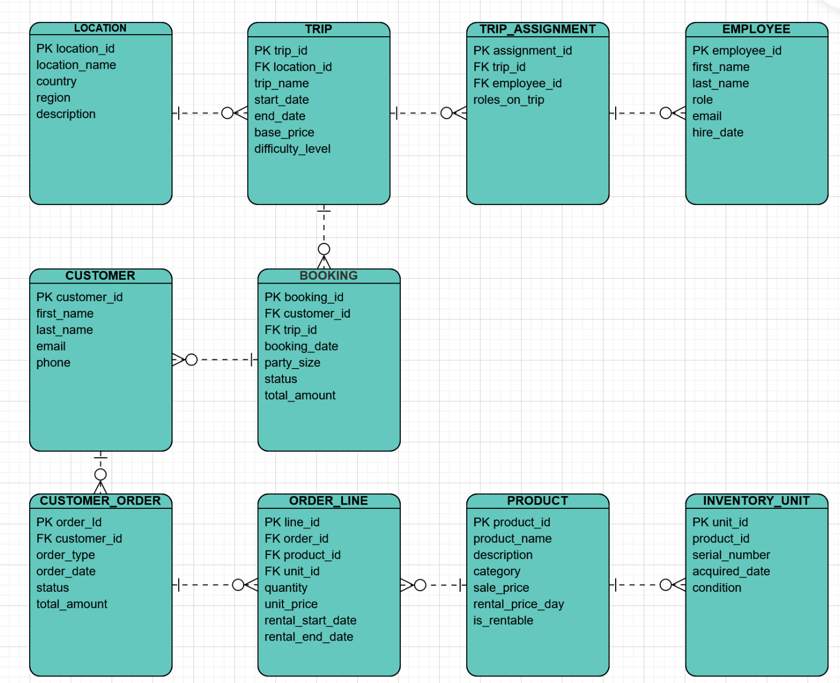
Final ERD:
Main Entities:
TRIP_ASSIGNMENT
ORDER_LINE
CUSTOMER_ORDER
INVENTORY_UNIT
PRODUCT
EMPLOYEE
BOOKING
CUSTOMER
TRIP
LOCATION
These entities allow the system to track trips, customers, employees, equipment inventory, and purchases or rentals.

Slide 6
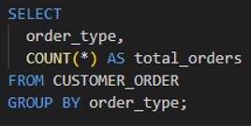
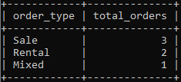
Equipment Sales vs Lease:
This report Tracks orders based on whether the equipment was purchased, leased or both.
Objective:
Determine if clients prefer to lease equipment rather than buying it to help the company determine if selling equipment remains profitable

Slide 7
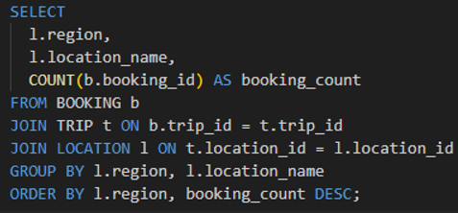
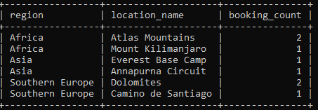
Trip booking by location:
Description:
This report show the numbers for each trip location
Objective:
Identify which places are most popular
Identify locations that may be experiencing a downward trend in bookings

Slide 8
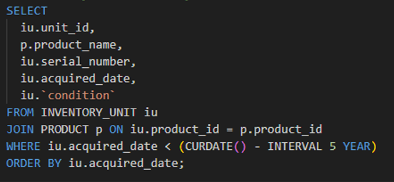
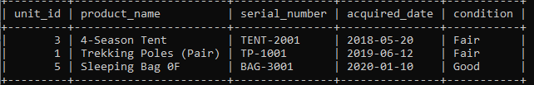
Inventory older than five years:
Description:
This report list equipments that were acquired more than 5 years ago
Objective:
Find outdated equipment
Help Decide which items should be replaced or removed

Slide 9
Assumptions Made:
Employees have one defined role
Trips occur at one location and require at least one guide
Customers must create an account before booking or ordering
Bookings link one customer to one trip
Booking statuses include Pending, Confirmed, Cancelled, Completed
Products can be rentable, purchasable, or both
Inventory items are tracked individually by product
Rental orders require start and end dates
Orders must include at least one order line
Customers may have multiple bookings and orders

Slide 10

Conclusion:
The database system developed for Outland Adventures offers a structured way to manage trips, equipment, and customer activity. Reports allow owners to analyze equipment sales, track trends by location, and monitor inventory status and age. This information will help them make better operational decisions.

